Slide 1
Designing Concurrent Software
Making good decisions

Slide 2
Two reasons for concurrency
We write concurrent code for two reasons
Maintain responsiveness during long operations
Divide work to accomplish more in less time
Writing concurrent code is difficult – don’t do it for any other reasons.

Slide 3
Patterns for responsiveness
I’ve seen three patterns occur often
Ad-hoc background thread
Expensive work is done on the background thread
Main thread only remains responsive for the user
Long running background thread(s)
Assigned tasks by producer/consumer queue
Background thread is a while loop
Exits when main thread signals it via condition variable or atomic
Command/query on independent threads
Either takes lock on data and executes to completion
Command mutates data, query reads data
Read/Write on different threads

Slide 4
Example: ad-hoc background thread
The GUI application which computes the value of pi uses this approach.

Slide 5
Example: Long running thread
Useful for two-way synchronization between two GUIs.
Call method and wait for response
Application 1
Application 2
GUI Thread
GUI Thread
Fire event and wait to be processed (no response)
Notes:
Always running on same machine, communicate via TCP connection
New application treats old one as a server
Makes calls across (like windows pumping thread)
If the one is busy, then it will just sit there and wait

Slide 6
Example: Long running thread
Use producer/consumer queue to push events off GUI thread
Call method and wait for response
Application 1
Application 2
GUI Thread
GUI Thread
Fire event and don’t wait to be processed
Fire event and wait to be processed (no response)
Producer
Consumer Thread

Slide 7
Command/query model
Divide actions on data into reads and writes
Command write (or mutate) data
Queries read data
Each command or query locks the data it will use, then executes
Provides flexibility
A command or query may execute
On GUI thread
On a background thread with a GUI wait
On a background thread with the GUI continuing *** best

Slide 8
Guidelines for responsiveness
These patterns are relatively well established
Used prior to pervasive multi-processing machines
Many libraries have these patterns built in
Guidelines
Write code sequentially, design a clean API, test it.
Apply one of the known patterns to execute it on a separate thread.
The domain-specific code and the threading code should not mix.
Notes:
*

Slide 9
Divide work to accomplish more
As multi-processor systems become pervasive taking advantage of those processors becomes important.
If task x requires time A to complete using one processor, can we use n processors to complete x in A/n time? (Linear scalablility)
We can divide the work in x one of three ways
Prior to executing x, partition in input data and perform x₁, x₂, x₃, etc.
During the execution of x, partition the input data and perform x₁, x₂, x₃, etc.
If x is a sequence of steps, perform each step in parallel on a stream of data
Approaches 1 and 2 parallelize based on data
Approach 3 parallelizes based on the algorithm
Notes:
1st 2: dividing up the data (scale with the size of the data)
3rd: dividing up the algorithm

Slide 10
Partitioning input data
Often referred to as map-reduce or task-based parallelism
The map portion partitions the data and performs task x on each partition.
The reduce portion combines the output of each task x.
Imagine we want to find the average of a list of numbers:
42 | 4 | 5 | 18 | 931 | 6 | 2 | -67
Thread 1
42 + 4 = 46
Thread 2
5 + 8 = 18
Thread 3
931 + 6 = 937
Thread 4
2 + -67 = -65
map
Main Thread
(46 + 18 + 937 + -65) / 8 = 117
reduce
Notes:
GOOGLE AND MAPREDUCE!!!!!!!
Reduce is a serial step

Slide 11
Partitioning during execution
Some algorithms require inspection of the data to partition it.
Quicksort recursively sorts subsections of the input
Each recursive call operates on an independent partition of the data
Each call can execute on a separate thread
42 | 4 | 5 | 18 | 931 | 6 | 2 | -67
Notes:
Like quicksort
Each step operates on more processors
Don’t see this much since requires special algorithm

Slide 12
Dividing work by task type
Many algorithms have a independent sequence of steps
Each part of the data may be an input to each step
The steps operate on a sequence of data
Each step can be executed on a separate thread.
This is often called pipelining.
42 | 4 | 5 | 18 | 931 | 6 | 2 | -67
Thread 1
Step 1
18
Thread 2
Step2
5
Thread 3
Step 3
4
931
42
Notes:
Used in high frequency trading algorithm since normal CPU’s don’t work (slow) – use VHDL and FPGAs (code it in hardware)

Slide 13
What is the best approach?
It depends on the situation!
Dividing work by task type
All of the patterns for responsiveness are special cases of this.
High frequency trading algorithms often operate on a stream of data.
Limits scalability, but requires known hardware
Partitioning during execution
Tied to specific algorithms
Difficult to determine hardware requirements
Partitioning input data ***
Usually input data is known and can be partitioned
Offer best chance to scale in the future

Slide 14
Performance vs. Scalability
These are two related, but different concepts.
Performance: the time an action takes to complete
Scalability: how the performance changes with more resources or a larger problem
Does performance improve as you add more processors? Often algorithms only scale well to 4 cores.
If it scales well, you’ve future-proofed your software
We have already seen the he need for increased performance has pushed CPU designs to more processors and cores.
Partitioning input provides the best potential for scalability
Therefore, it provides the best potential for future performance

Slide 15
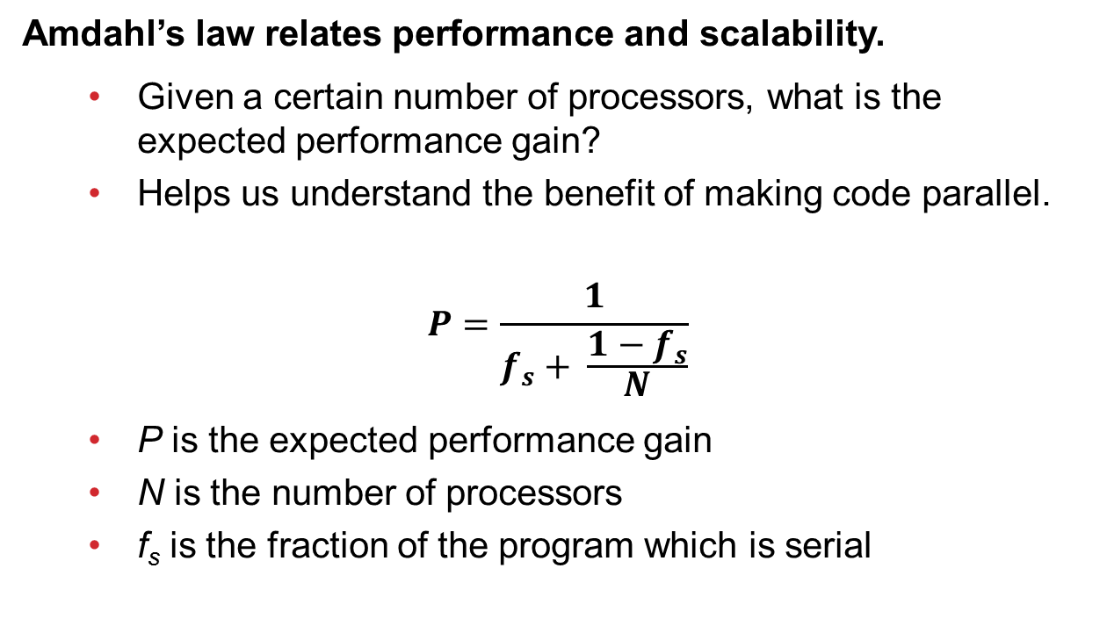
Amdahl’s Law
Amdahl’s law relates performance and scalability.
Given a certain number of processors, what is the expected performance gain?
Helps us understand the benefit of making code parallel.
$$P=\frac{1}{f_{s}+ \frac{1−f_{s}}{N}}$$
P is the expected performance gain
N is the number of processors
f_{s} is the fraction of the program which is serial

Slide 16
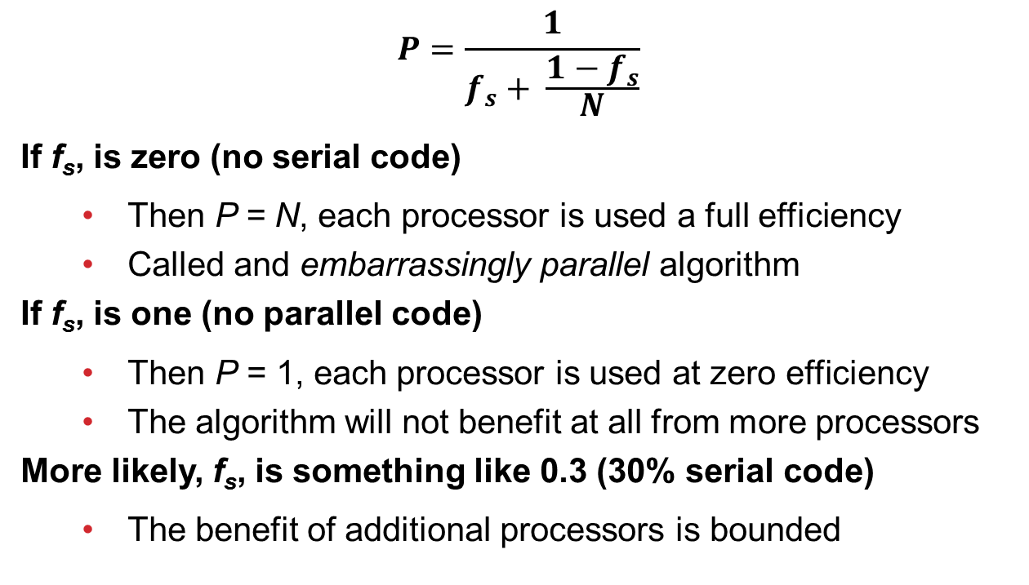
Exploring Amdahl’s law
$$P=\frac{1}{f_{s}+ \frac{1−f_{s}}{N}}$$
If f_{s}, is zero (no serial code)
Then P = N, each processor is used a full efficiency
Called and embarrassingly parallel algorithm
If f_{s}, is one (no parallel code)
Then P = 1, each processor is used at zero efficiency
The algorithm will not benefit at all from more processors
More likely, f_{s}, is something like 0.3 (30% serial code)
The benefit of additional processors is bounded

Slide 17
Plot of Amdahl’s Law
Determining the value of f_{s} is often difficult.

Slide 18
Minimizing serial code
How do we minimize f_{s}? – Eliminate sharing
Limit code which is I/O bound
I/O is usually shared
I/O is usually slow
Avoid oversubscription – more threads than cores
Leads to time spent context switching in CPUs
Effectively sharing CPU registers
Limit shared data
Minimize data used by the algorithm that is shared
Minimize the number of mutexes – they are always shared
Minimize the number of atomics – they are always shared
Understand cache size and performance

Slide 19
Understanding cache layout
Good cache is the key factor to improving performance of concurrent code in my experience.
A cache is a small, fast segment of memory.
Caches are often provided in levels, where each level is used by more processors.
CPU1
CPU2
CPU3
CPU4
L1 Cache
L1 Cache
L1 Cache
L1 Cache
L2 Cache
L2 Cache
L3 Cache

Slide 20
Understanding cache layout
Caches operate on cache lines, usually 32 or 64 bytes segments of memory.
23 | 53 | 8 | 886 | 7456 | 3 | -4 | 18
H | E | L | L | O |  | W | O
R | L | D | ! | 0 | 15 | 2.3 | -90.1
30 | 18 | 992 | -421 | 6 | 7 | 8 | 9
23 | 53 | 8 | 886 | 7456 | 3 | -4 | 18
A read from one memory location causes the line to be loaded in cache.
A write to one memory location causes the line to be written to memory.

Slide 21
Problems with cache
Understanding how cache can impact the performance of concurrent code is important.
Cache ping-pong: If two threads are reading from a memory location and one thread writes to it, then
Each read and write must go to main memory
Eliminates the performance advantage of cache
To fix it: avoid mutexes – especially in loops
False sharing: If two threads read or write data which is on the same cache line, then
Each read and write must go to main memory
Eliminates the performance advantage of cache
To fix it: keep data used by different threads separated
These problems are difficult to detect – measure them!

Slide 22
Benefits of cache
Use the speed and size of cache to your advantage.
Understand as much about your target CPU architectures as possible.
How large are the caches?
What are the cache line sizes?
How many levels of cache exist?
How are the caches shared?
Keep data used on one thread close in memory.
Prefer contiguous arrays of data.
Avoid data structures with heap-allocated memory. (like list (linked))
These benefits are difficult to find – measure them!

Slide 23
Summary of Guidelines
Guidelines
Write code sequentially, design a clean API, test it.
Apply one of these (or other) known patterns to execute it on a separate thread
The domain-specific code and the threading code should not mix
Measure impact of cache used on performance.

